Slide 1

Microwave Data Using ASF
Indian Institute Of Technology, Bombay
For Prayagraj (B)
Student Name: Riya Sunil Kharade
Guided BY : Prof. Gulab Singh
Subject : Microwave Satellite Data Processing

Slide 2
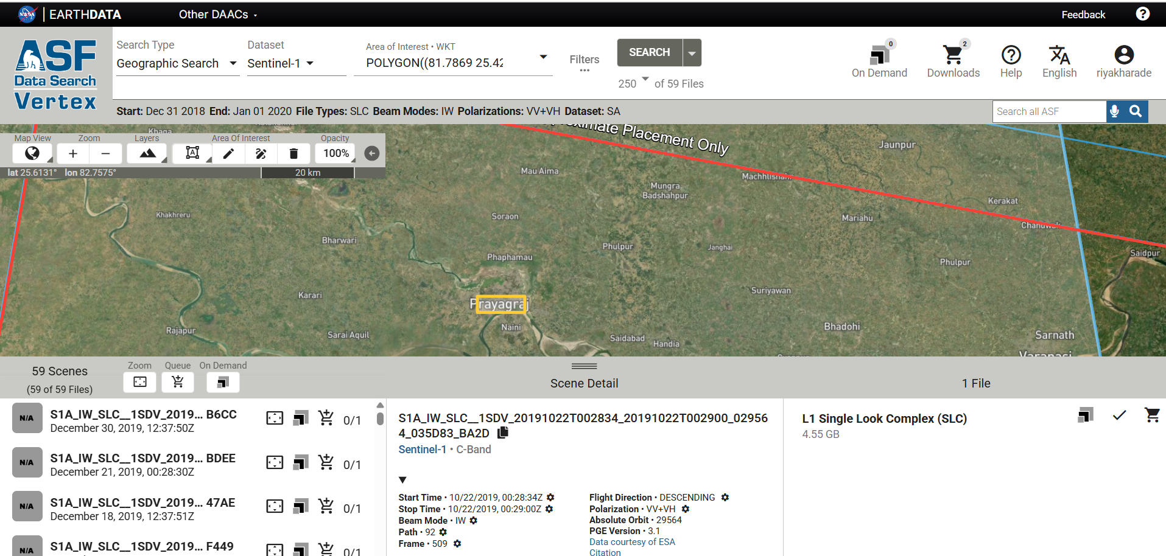
Data Downloading Using ASF for Prayagraj

Slide 3
Import S1 B Data /S1 Tops- Split
Drag and Drop folder

Slide 4
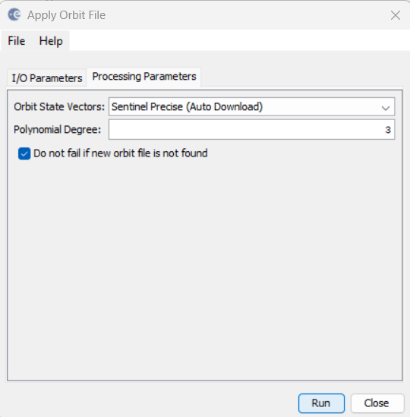
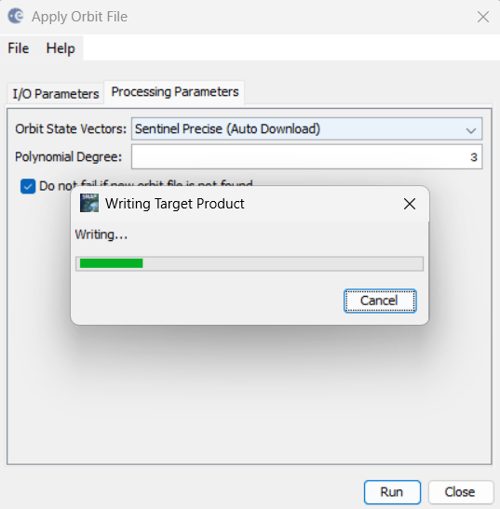
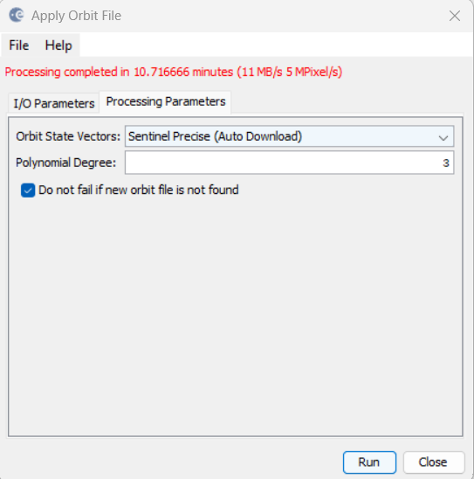
Step 1: Apply Arbit File
Radar-Apply Arbit File-Run

Slide 5
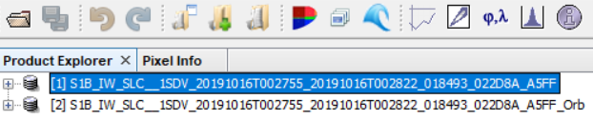
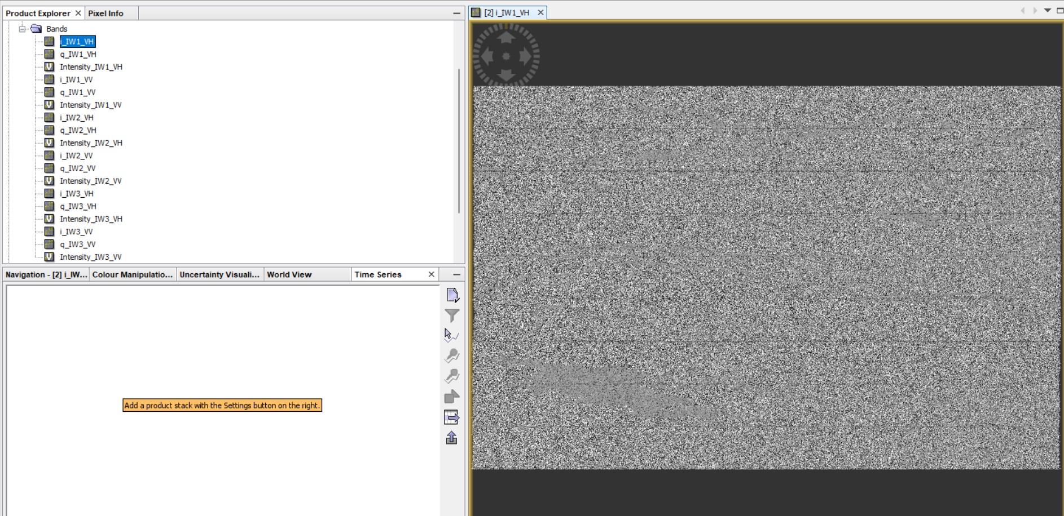
OUTPUT

Slide 6
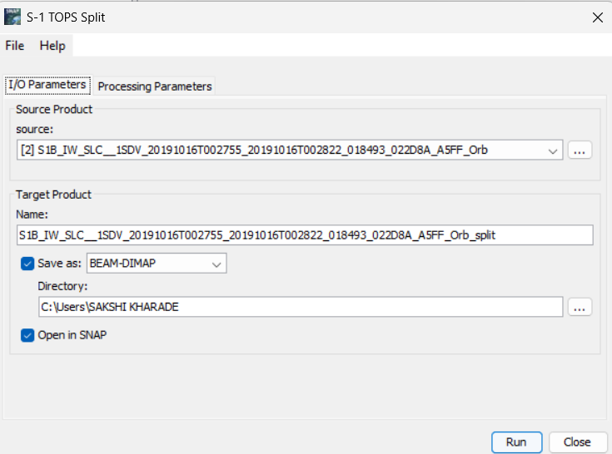
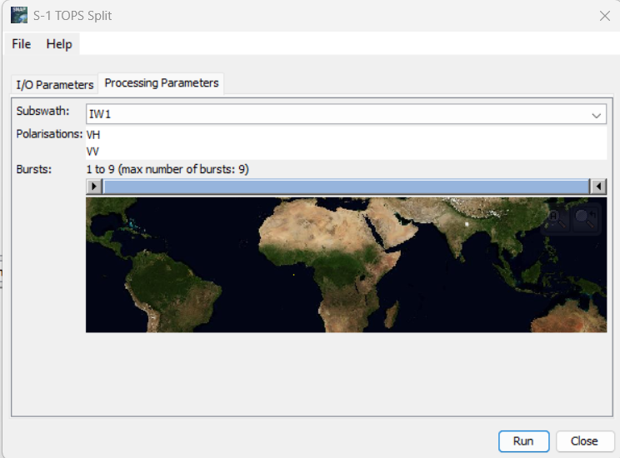
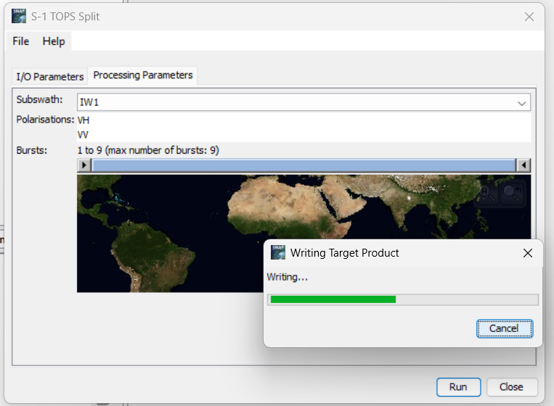
Step 2: Split
Radar-Sentinel 1 TOPS – S1 TOPS Split

Slide 7
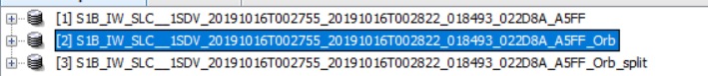
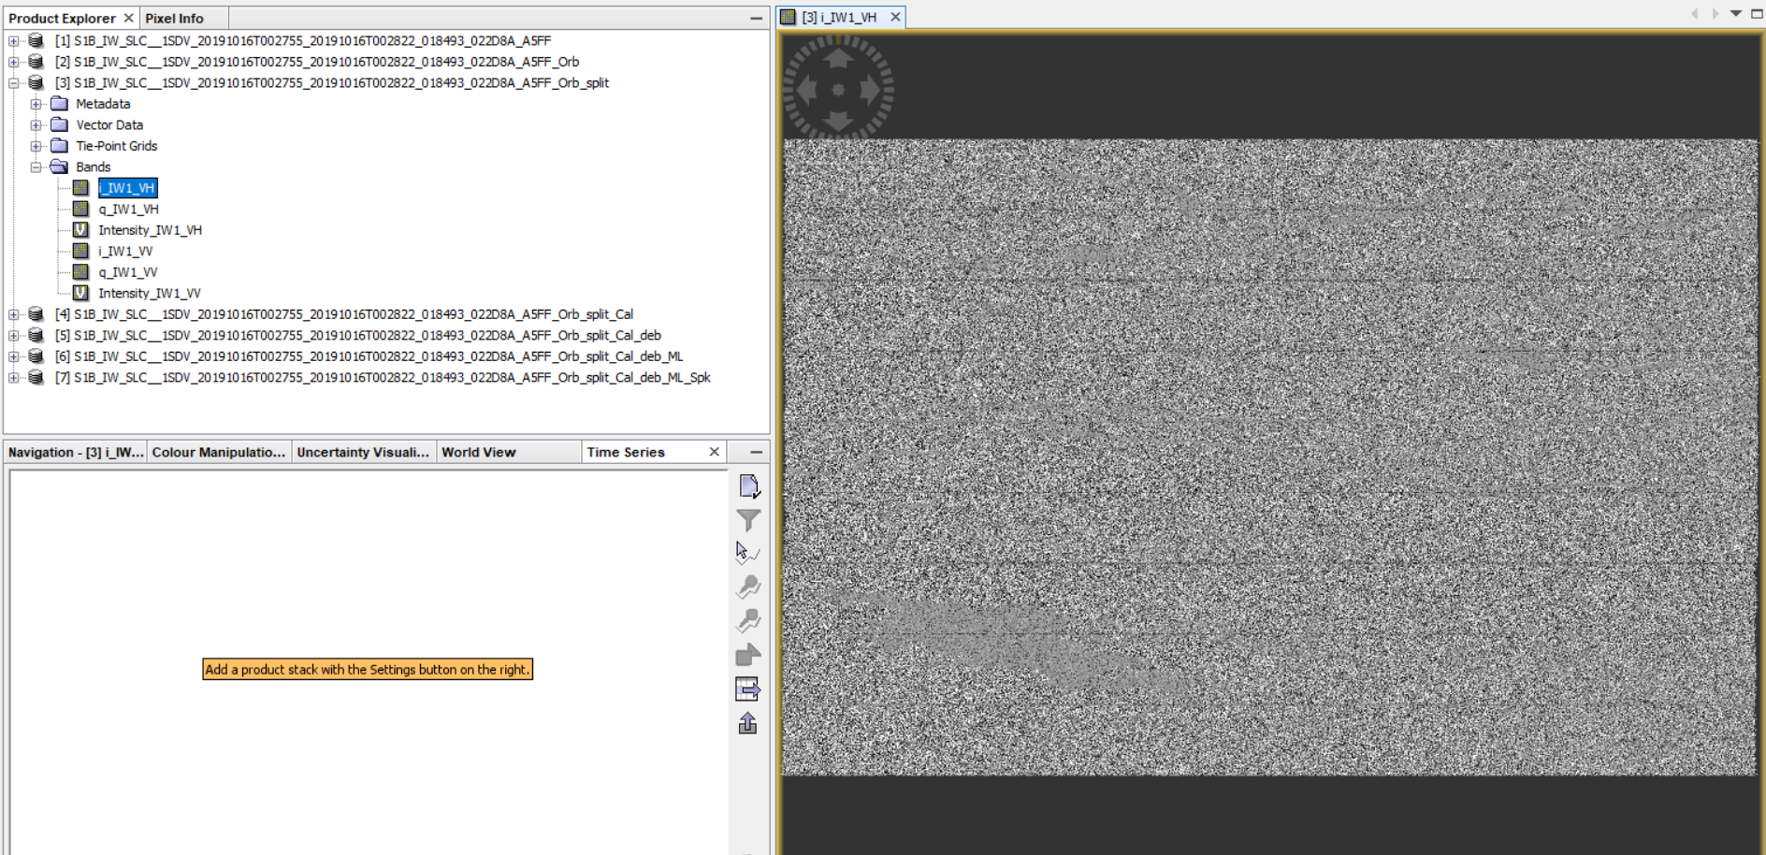
OUTPUT

Slide 8
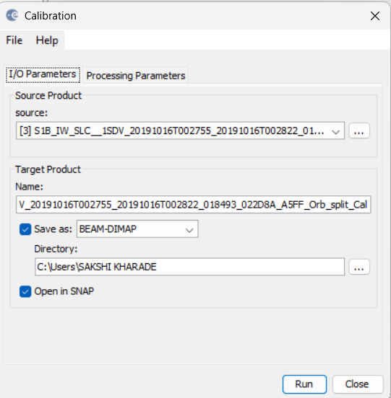
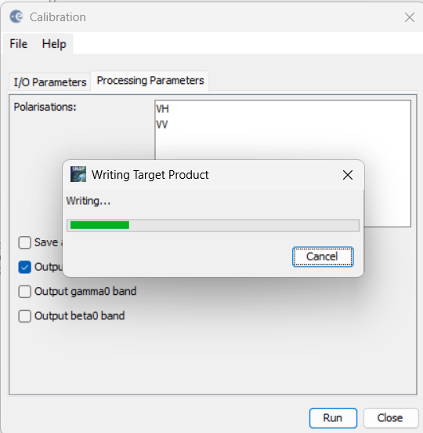
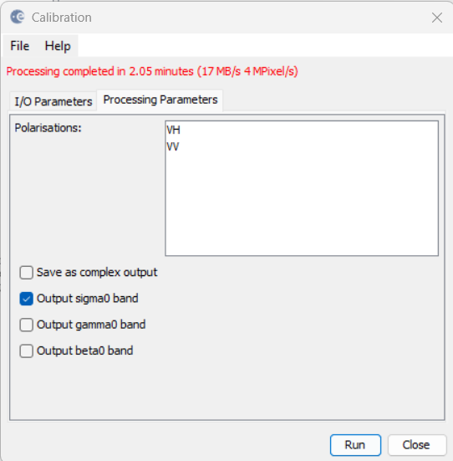
Step 3: Calibration
Radar-Radiometric-Calibration

Slide 9
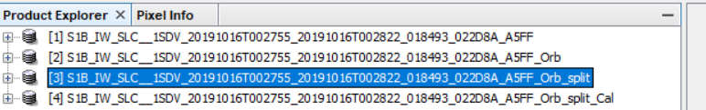
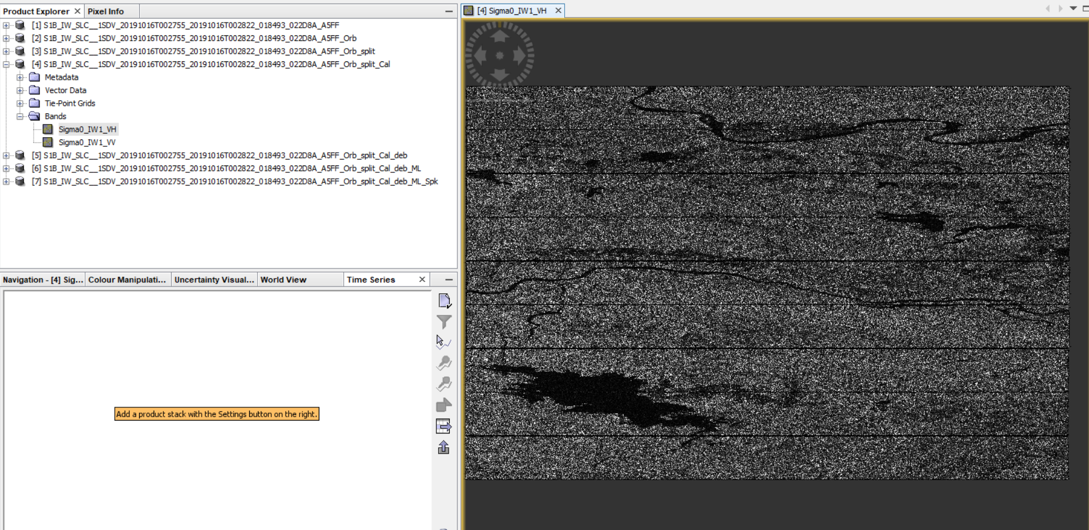
OUTPUT

Slide 10
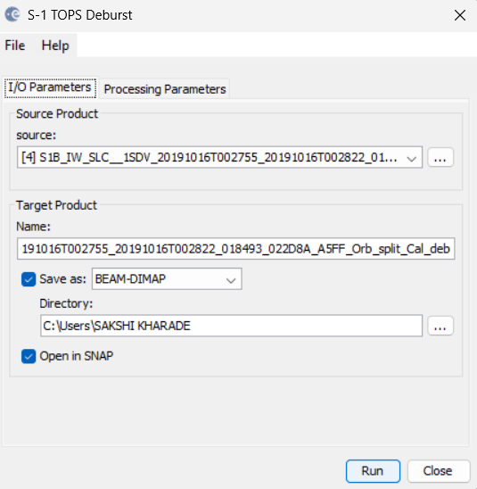
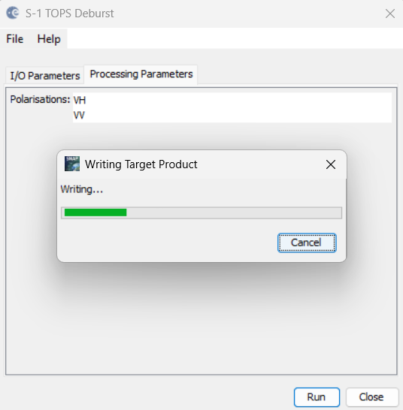
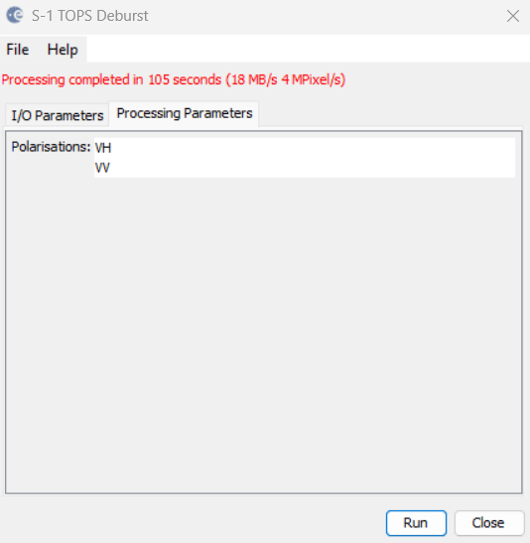
Step 4: Deburst
Radar-Sentinel 1 TOPS- S1 TOPS Deburst

Slide 11
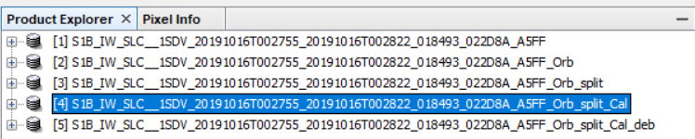
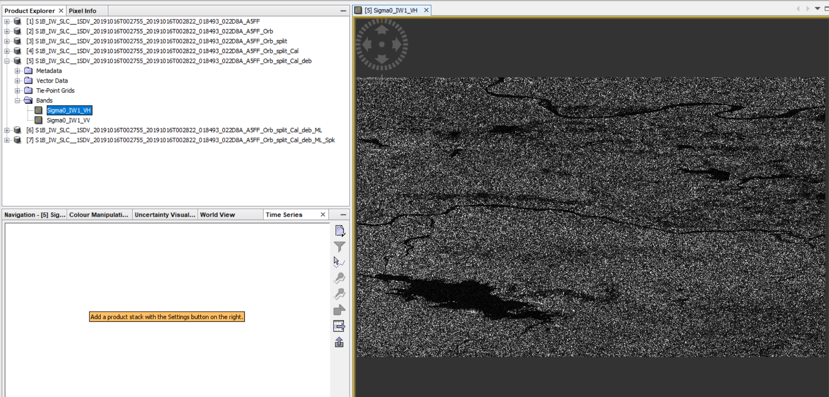
OUTPUT

Slide 12
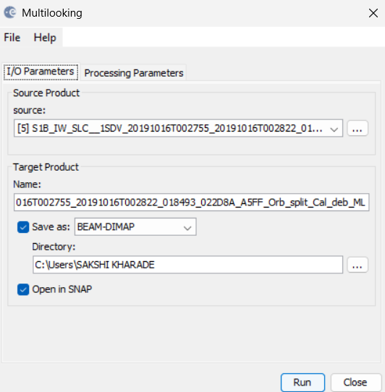
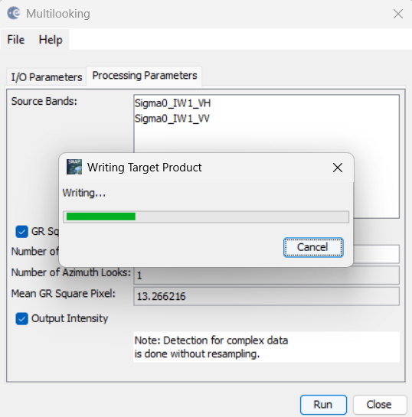
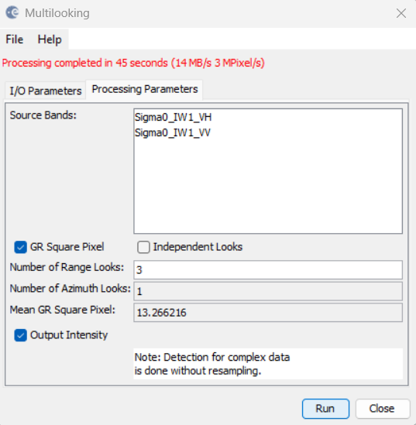
Step 5: Multilooking
Radar-SAR Utilities-Multilooking

Slide 13
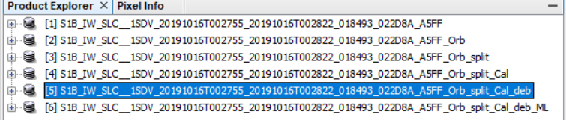
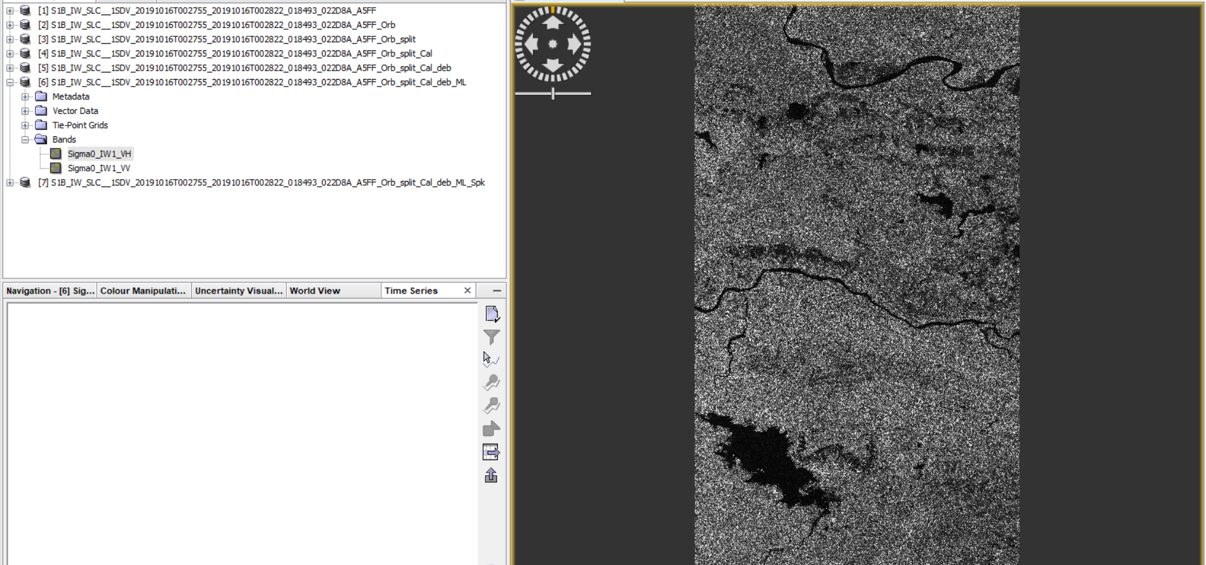
OUTPUT

Slide 14
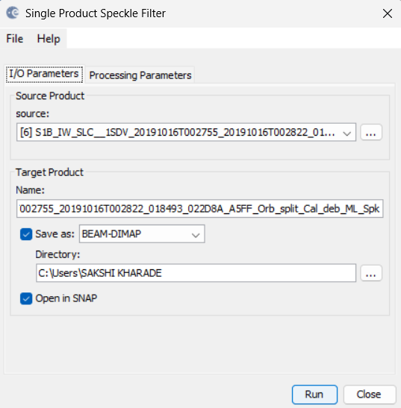
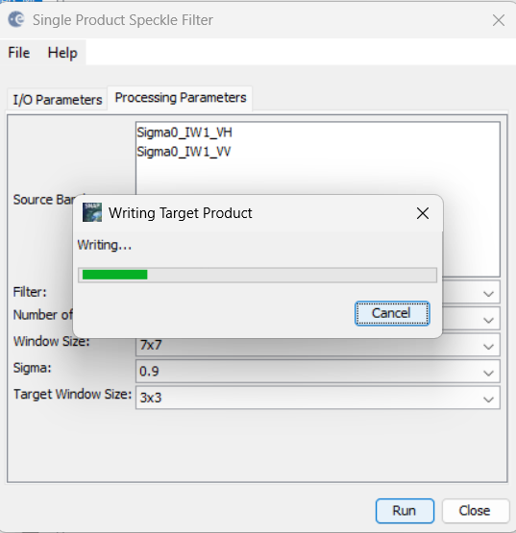
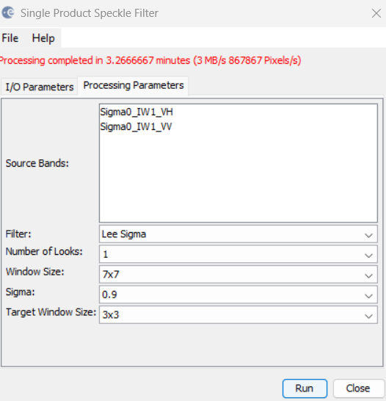
Step 6: Speckle Filtering
Radar-Speckel Filtering-Single Product Speckle Filtering

Slide 15
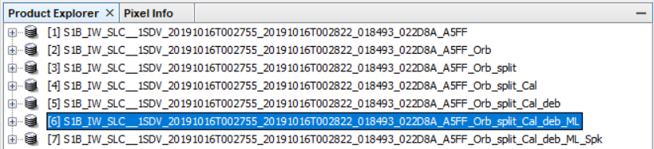
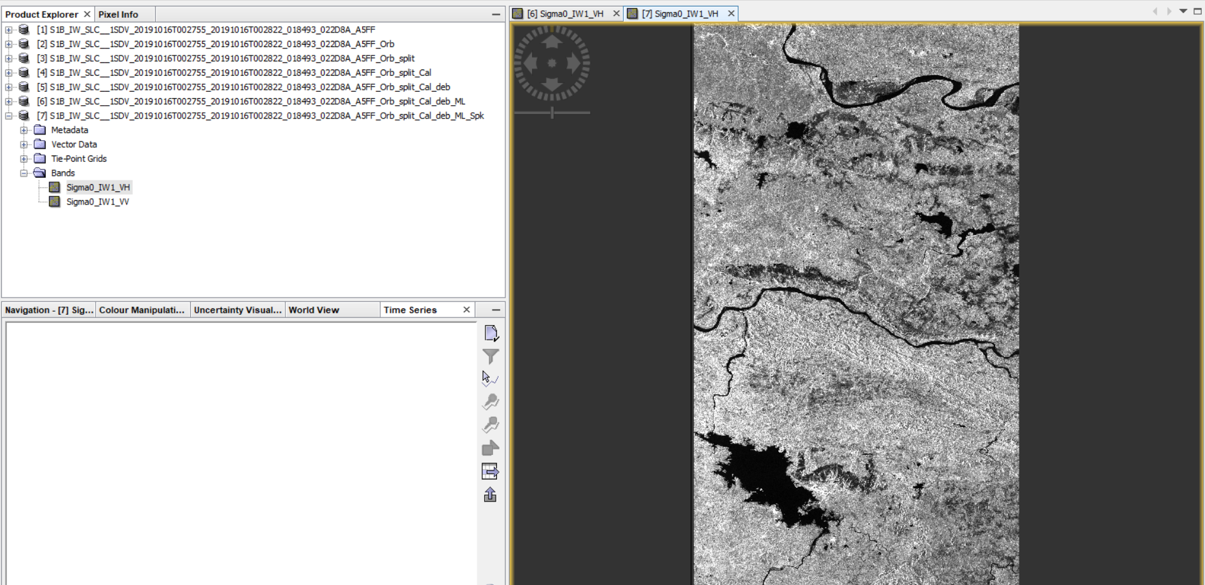
OUTPUT

Slide 16
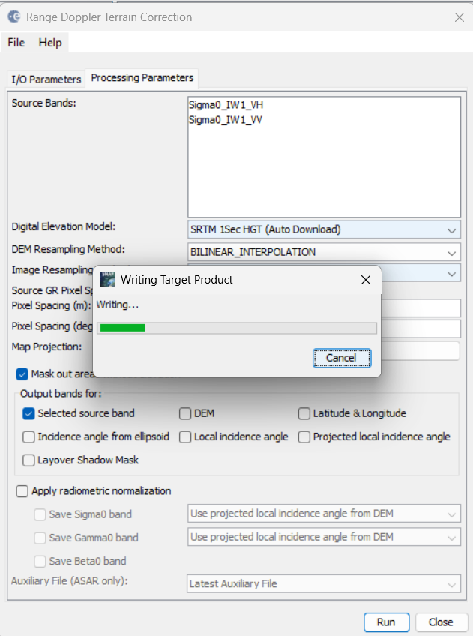
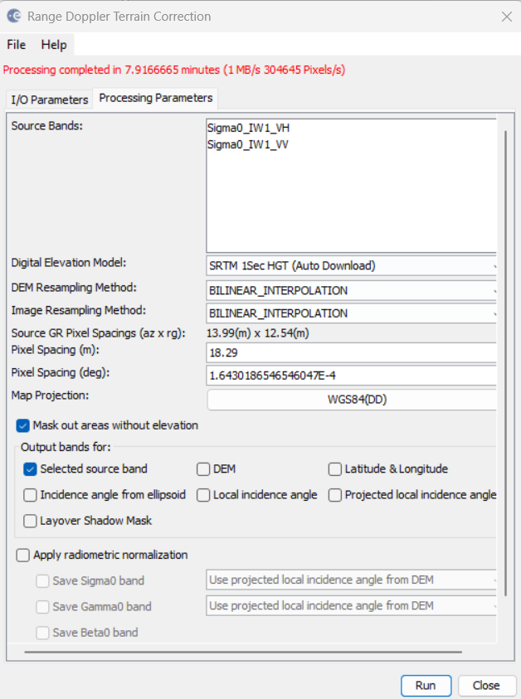
Step 7:Range-Doppler Terrain Correction
Radar-Geometric-Terrain Correction-Range Doppler Terrain Correction

Slide 17
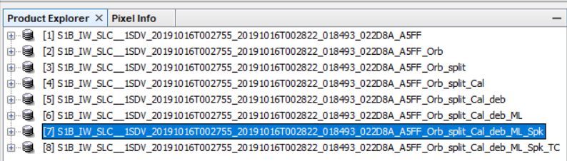
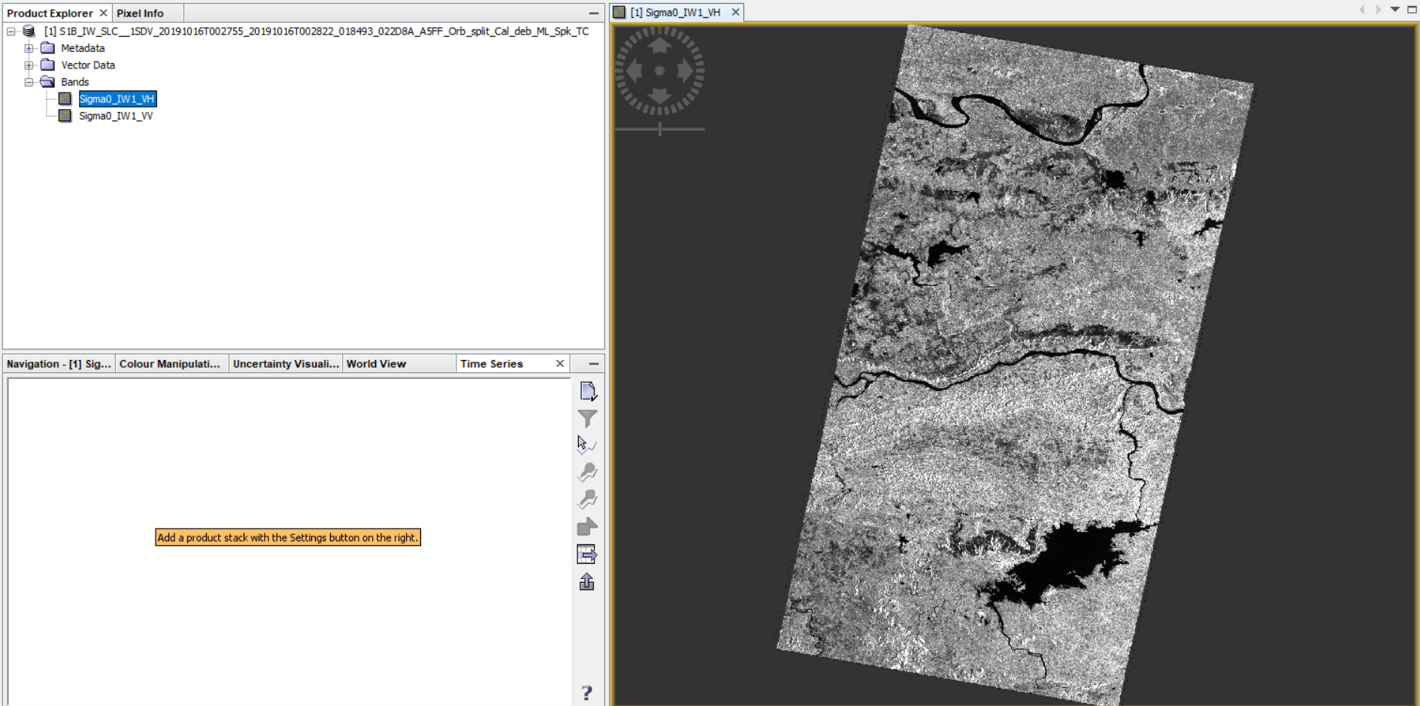
OUTPUT

Slide 18
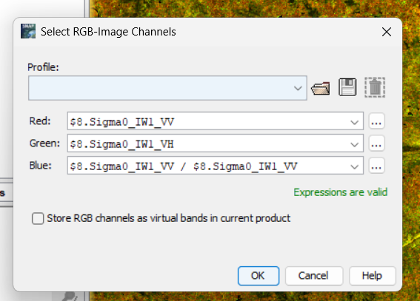
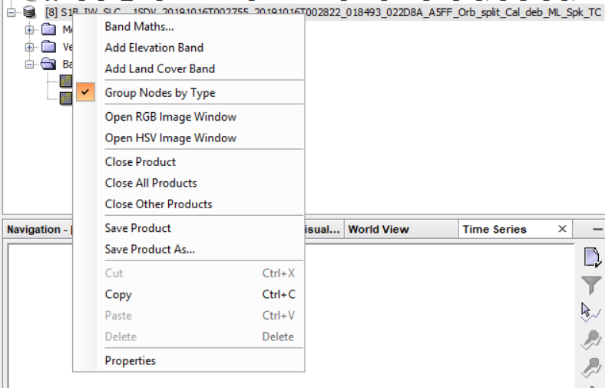
Step 8: RGB Image Window
Right Click On TC file-Open RGB Image Window

Slide 19
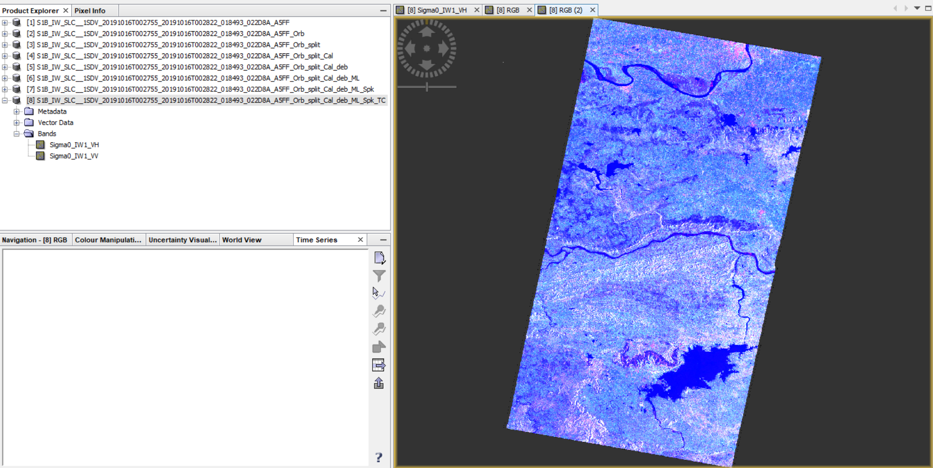
OUTPUT

